Slide 1
Core Java
FILE IO
Md. Minhajur Rahman
OCPJP, SSE, BJIT Limited

Slide 2


Files and I/O
The java.io package contains nearly every class you might ever need to perform input and output (I/O) in Java. All these streams represent an input source and an output destination. The stream in the java.io package supports many data such as primitives, object, localized characters, etc.
InputStream
OutputStream
The InputStream is used to read data from a source
The OutputStream is used for writing data to a destination

Slide 3

Files and I/O
Java byte streams are used to perform input and output of
8-bit bytes. Though there are many classes related to byte streams but the most frequently used classes are, FileInputStream and FileOutputStream.

Slide 4
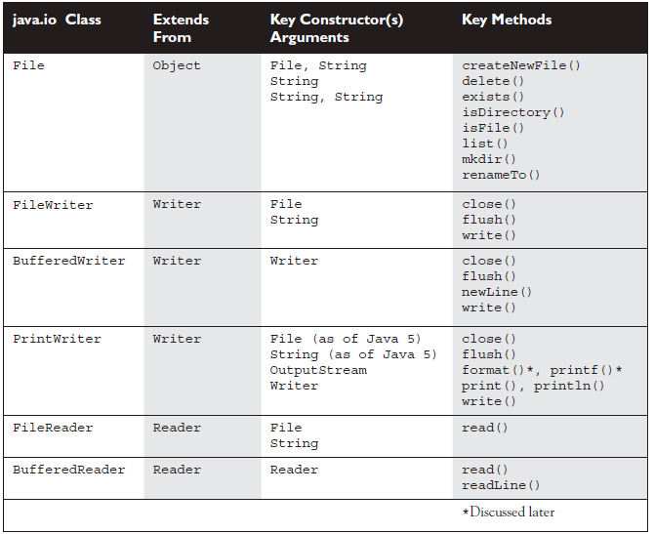
Mini IO

Slide 5
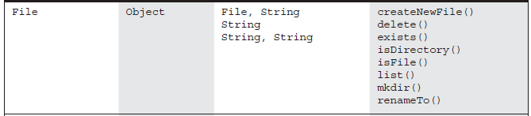
File Class
The API says that the class File is "An abstract representation of file and directory pathnames.“
The File class isn't used to actually read or write data;
It’s used to work at a higher level, making new empty files, searching for files, deleting files, making directories, and working with paths.
Therefore, the physical file/directory that a File object references does not need to exist.
The main advantage of File is that it provides a system-independent way of representing a pathname.

Slide 6
Example File Class
public File(java.lang.String pathname)
  File file1 = new File("C:\\temp\\myNote.txt"); // in Windows
  File file2 = new File("/tmp/myNote.txt"); // in Linux/Unix
  File file = new File( "fileWrite2.txt");
userSelectedDir is a directory selected by the user at runtime and filename is a String containing the name of the file.
  File myFile = new File(userSelectedDir + File.separator + filename);
public File(java.lang.String parent, java.lang.String child)
File myFile = new File(userSelectedDir, fileName);
public File(File parent, String.java.lang child)
File dir= new File(“mydir”);
File myFile = new File(dir, fileName);

Slide 7

Important FILE Methods
public boolean canRead()
  Tests if the application can read the file referenced by this File object.
public boolean canWrite()
  Tests if the application can write to the file referenced by this File object.
public boolean createNewFile() throws IOException
  Creates a new empty file in the location and using the name denoted by this File object.
public boolean delete()
  Deletes the file or directory referenced by this File object.
public boolean makeDir()
  Creates the directory named by this File object.
public boolean isFile()
  Tests if this File object references a file.
public boolean isDirectory()
  Tests if this File object references a directory.

Slide 8
Important FILE Methods
public boolean exists()
Tests if the file or directory denoted by this File object exists.
public File[] listFiles()
If this File object denotes a directory, this method returns an array of File objects referencing the subdirectories and files in the directory. Otherwise, returns null.
public long getTotalSpace()
Returns the size, in bytes, of the partition referenced by this File object.
public long getFreeSpace()
Returns the amount of free space, in bytes, in the partition referenced by this File object.
public long getUsableSpace()
Returns the number of bytes available to this virtual machine on the partition referenced by this File object. The difference between getUsableSpace and getFreeSpace is that the former takes into account restrictions imposed by the operating system, such as write permissions. The latter does not.

Slide 9

File Class
import java.io.*;
class Writer1 {
  public static void main(String [] args) {
    try { // warning: exceptions possible
      boolean newFile = false;
      File file = new File("fileWrite1.txt");
      System.out.println(file.exists()); // look for a real file
      newFile = file.createNewFile(); // maybe create a file!
      System.out.println(newFile); // already there?
      System.out.println(file.exists()); // look again
      } catch(IOException e) { }
}
}

Slide 10
File Reader & File Writer
FileReader:
This class is used to read character files.
Its read() methods are fairly low-level, allowing you to read single characters, the whole stream of characters, or a fixed number of characters.
FileReaders are usually wrapped by higher-level objects such as BufferedReaders, which Improve performance and provide more convenient ways to work with the data.

Slide 11

File Reader & File Writer
FileWriter:
This class is used to write to character files.
Its write() methods allow you to write character(s) or Strings to a file.
FileWriters are usually wrapped by higher-level Writer objects such as BufferedWriters or PrintWriters, which provide better performance and higher-level, more flexible methods to write data.

Slide 12
Example of File Reader & File Writer
import java.io.*;
class Writer2 {
public static void main(String [] args) {
char[] in = new char[50]; // to store input
int size = 0;
try {
File file = new File("fileWrite2.txt");
FileWriter fw =new FileWriter(file);
// create an actual file// & a FileWriter obj
fw.write("howdy\nfolks\n");
// write characters to the file
fw.flush(); // flush before closing
fw.close(); // close file when done
FileReader fr =new FileReader(file);
// create a FileReader object
size = fr.read(in); // read the whole file!
System.out.print(size + " "); // how many bytes read
for(char c : in) // print the array
System.out.print(c);
fr.close(); // again, always close
} catch(IOException e) { }
}
}
Notes:
The Java platform stores character values using Unicode conventions. Character stream I/O automatically translates this internal format to and from the local character set. In Western locales, the local character set is usually an 8-bit superset of ASCII.
For most applications, I/O with character streams is no more complicated than I/O with byte streams. Input and output done with stream classes automatically translates to and from the local character set. A program that uses character streams in place of byte streams automatically adapts to the local character set and is ready for internationalization — all without extra effort by the programmer.

Slide 13
BufferedReader & BufferedWriter
BufferedReader:
This class is used to make lower-level Reader classes like FileReader more efficient and easier to use.
Compared to FileReaders, BufferedReaders read relatively large chunks of data from a file at once, and keep this data in a buffer.
When you ask for the next character or line of data, it is retrieved from the buffer, which minimizes the number of times that time-intensive, file read operations are performed.

Slide 14

BufferedReader & BufferedWriter
BufferedWriter:
This class is used to make lower-level classes like FileWriters more efficient and easier to use.
Compared to FileWriters, BufferedWriters write relatively large chunks of data to a file at once, minimizing the number of times that slow, file writing operations are
performed.
The BufferedWriter class also provides a newLine() method to create platform-specific line separators automatically.

Slide 15
Example of BufferedReader & BufferedWriter
import java.io.*;
class Writer3 {
public static void main(String [] args) {
char[] in = new char[50]; // to store input
int size = 0;
try {
File file = new File("fileWrite2.txt");
FileWriter fw =new FileWriter(file);
// create an actual file// & a FileWriter obj
BufferedWriter bw =new BufferedWriter(fw);
bw.write("howdy”);
bw.newLine();
bw.write(“folks”); // write characters to the file
bw.flush(); // flush before closing
bw.close(); // close file when done
FileReader fr =new FileReader(file);
// create a FileReader object
BufferedReader br =new BufferedReader(fr);
String s;
while( (s = br.readLine()) != null) // read data
System.out.println(s);
br.close(); // again, always close
} catch(IOException e) { }
}
}
Notes:
The Java platform stores character values using Unicode conventions. Character stream I/O automatically translates this internal format to and from the local character set. In Western locales, the local character set is usually an 8-bit superset of ASCII.
For most applications, I/O with character streams is no more complicated than I/O with byte streams. Input and output done with stream classes automatically translates to and from the local character set. A program that uses character streams in place of byte streams automatically adapts to the local character set and is ready for internationalization — all without extra effort by the programmer.

Slide 16


PrintWriter
This class has been enhanced significantly in Java 5.
Because of newly created methods and constructors (like building a PrintWriter with a File or a String), you might find that you can use PrintWriter in places where you previously needed a Writer to be wrapped with a FileWriter and/or a BufferedWriter.
New methods like format(), printf(), and append() make PrintWriters very flexible and powerful.

Slide 17
Example of PrintWriter
import java.io.*;
class iWriter4 {
public static void main(String [] args) {
char[] in = new char[50]; // to store input
int size = 0;
try {
File file = new File("fileWrite2.txt");
FileWriter fw =new FileWriter(file);
// create an actual file// & a FileWriter obj
PrintWriter pw = new PrintWriter(file);
pw.println("howdy"); // write the data
pw.println("folks");
pw.flush(); // flush before closing
pw.close(); // close file when done
FileReader fr =new FileReader(file);
// create a FileReader object
BufferedReader br =new BufferedReader(fr);
String s;
while( (s = br.readLine()) != null) // read data
System.out.println(s);
br.close(); // again, always close
} catch(IOException e) { }
}
}
Notes:
The Java platform stores character values using Unicode conventions. Character stream I/O automatically translates this internal format to and from the local character set. In Western locales, the local character set is usually an 8-bit superset of ASCII.
For most applications, I/O with character streams is no more complicated than I/O with byte streams. Input and output done with stream classes automatically translates to and from the local character set. A program that uses character streams in place of byte streams automatically adapts to the local character set and is ready for internationalization — all without extra effort by the programmer.

Slide 18

I/O From Command Line
A program is often run from the command line and interacts with the user in the command line environment. The Java platform supports this kind of interaction through the Standard Streams
The Java platform supports three Standard Streams: Standard Input, accessed through System.in; Standard Output, accessed through System.out; and Standard Error, accessed through System.err.

Slide 19
I/O From Command Line
    import java.io.*;
    public class ReadStandardIO{
    public static void main(String[] args) throws IOException{
    InputStreamReader inp = new InputStreamReader(System.in);
    BufferedReader br = new BufferedReader(inp);
    System.out.println("Enter text : ");
    String str = br.readLine();
    System.out.println("You entered String : ");
    System.out.println(str);
    }
    }

Slide 20

Object Serialization
You sometimes need to persist objects in memory into permanent storage so that the states of the objects can be retained and later retrieved. Java supports this through object serialization.
To save objects to permanent storage, you use an ObjectOutputStream. To deserialize objects, namely to retrieved saved objects, use ObjectInputStream.
The ObjectOutputStream class has one public constructor:
public ObjectOutputStream(OutputStream out)

Slide 21
Object Serialization
Therefore, to serialize objects to a file, you can pass a FileOutputStream to the constructor. Once you have an ObjectOutputStream, you can serialize objects or primitives or the combination of both.
For objects to be serializable their classes must implement the java.io.Serializable interface. This interface has no method and is a marker interface.
A marker interface is one that tells the JVM that an instance of an implementing class belongs to a certain type.

Slide 22
ObjectOutputStream Details
The ObjectOutputStream class provides the writeXXX methods for each individual type, where XXX denotes a type. Here is the list of the writeXXX methods.
  public void writeBoolean(boolean value)
  public void writeByte(int value)
  public void writeBytes(String value)
  public void writeChar(int value)
  public void writeChars(String value)
  public void writeDouble(double value)
  public void writeFloat(float value)
  public void writeInt(int value)
  public void writeLong(long value)
  public void writeShort(short value)
  public void writeObject(java.lang.Object value)

Slide 23
ObjectInputStream Details
The ObjectInputStream class has a public constructor:
public ObjectInputStream(InputStream in)
Therefore, to deserialize from a file, you can pass a FileInputStream to the constructor.
The ObjectInputStream class has methods that are the opposites of the writeXXX methods in ObjectOutputStream.
They are as follows:
  public boolean readBoolean()
  public byte readByte()
  public char readChar()
  public double readDouble()
  public float readFloat()
  public int readInt()
  public long readLong()
  public short readShort()
  public java.lang.Object readObject()

Slide 24

Exercise
Consider the employee class below. Create some employee instances and save those instance in file.
Then read those object back from the file.
  class Employee {
  String name;
  String designation;
  Double salary;
  Department department
  }
  Class Department{
  String name;
  String section
  }

